Slide 1

Agile Development By Seth Brien 19 October 2025 CS 250

Slide 2
Introduction
Software Development Lifecycle (SDLC) is the process that a development team uses to design, develop, and test deployable software.
Agenda to go over key facets of the Agile methodology, contrast it with the current Waterfall model, and help leadership make an informed decision.
Agile and Scrum Roles
Agile Phases in the SDLC
Waterfall Model
Waterfall vs Agile: Comparison
Factors to Consider

Slide 3
Agile Roles
Scrum Master
Provides Agile principles guidance
Facilitates stakeholder collaboration and Scrum events
Addresses impediments and removes barriers
Product Owner
Communicates Product Goal and Product Backlog
Ensures the Product Backlog is refined and understood
Maximizes the development team’s work towards the product
Development Team
Developers implement functions while testers ensure function is accurate to client vision
Self-organized, usually based around strengths
Adaptable in their daily plan

Slide 4

Agile Phases
Concept:
Creating project vision
Collaborate with stakeholders
Gather requirement
Inception:
Backlog refinement
Team assignments
Iteration:
Create software architecture
Blueprint functionality
Testing:
Ensure product functions as intended
Gather usable feedback
Deployment:
End users get hands on
Can be beta test
Maintenance:
Continued support to remain functional

Slide 5
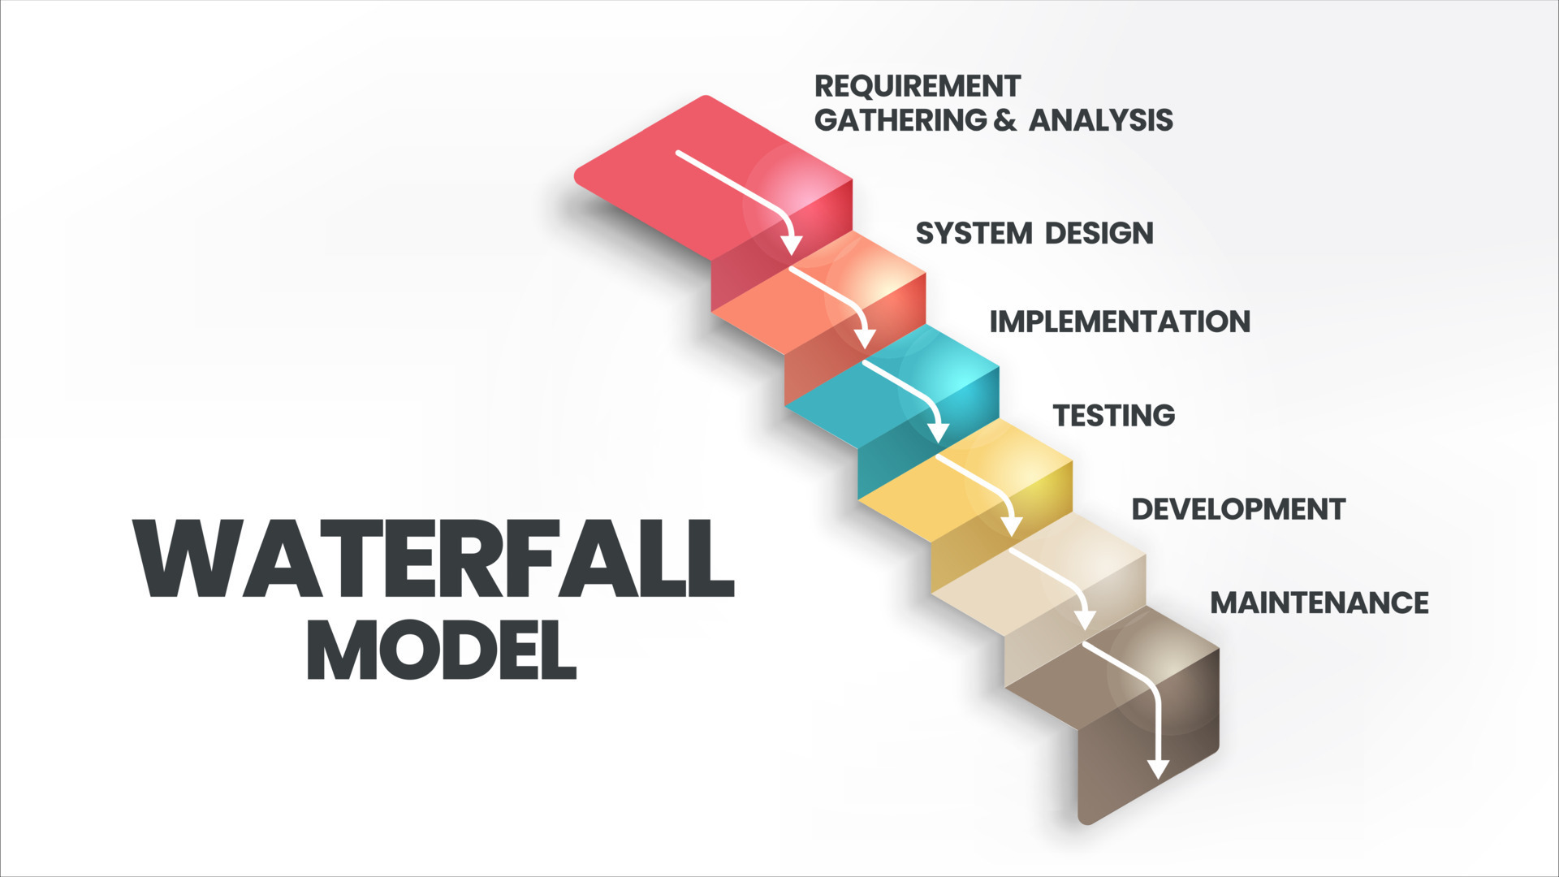
Waterfall model
Current model is based on the Waterfall approach which is linear, sequential phases:
Requirements → Design → Implementation → Testing → Development → Maintenance
How would this affect ChadaTech:
All SNHU Travel requirements locked in at beginning, product is designed, built, and tested with minimal feedback. Product then deploys.
The PROS:
Clear well-defined structure that is easy to follow
Timeline is mapped out at beginning, so it becomes predictable
All documentation is created up front
The CONS:
Little to no flexibility
Late in the process feedback (product is fully built out which makes updates difficult)

Slide 6
Waterfall vs agile: comparison
Waterfall
Low flexibility – makes any changes costly
Customer is only involved at milestones when product is almost fully developed
Testing is done after development phase on the whole product
Needs to be predictable in risk management as phases are more concrete in timelines
Best suited for a fixed scope and well-defined requirements
Agile
High flexibility – able to adapt to changes during each phase
Customer is involved throughout the whole lifecycle via Product Owner’s responsibility
Tested in each iteration of development
Early feedback reduces risks
Best suited for uncertain requirements and evolving scope from clients

Slide 7

Factors to consider when choosing approach
Project Complexity and Size:
How complex is the project and what is the scope?
Requirements:
Does the client seem sure about their product requirements?
Stakeholder Engagement:
Does the client want to be heavily involved in the development lifecycle?
Team Dynamics:
Will a larger or smaller team be heading the project?

Slide 8
References
Alexander, M. (2020, Oct 5). Agile vs. waterfall: Project methodologies compared. CIO. https://www.cio.com/article/194093/agile-vs-waterfall-project-methodologies-compared.html CIO
IBM. (n.d.). Agile vs. waterfall: Which project management methodology should you use?
IBM Think. https://www.ibm.com/think/topics/agile-vs-waterfall IBM
Shaydulin, R., & Sybrandt, J. (2017). To Agile, or not to Agile: A comparison of software development methodologies. arXiv. https://arxiv.org/abs/1704.07469arXiv
Van Casteren, W. (2017, Feb). The Waterfall Model and the Agile Methodologies: A comparison by project characteristics. Open University of the Netherlands.
Rafalski, K. (2024). 5 Top SDLC Methodologies: Choosing The Right One in 2024. Netguru.com; Netguru. https://www.netguru.com/blog/sdlc-methodologies
‌
Zhezherau, A. (2022). The Agile Software Development Life Cycle | Wrike Agile Guide. Wrike. https://www.wrike.com/agile-guide/agile-development-life-cycle/
‌
Schwaber, K., & Sutherland, J. (2020, November). The 2020 Scrum Guide. Scrumguides.org. https://scrumguides.org/scrum-guide.html
‌

Slide 9
Thank you
Seth Brien

